Slide 1
Multi-Period Optimization for Active Radial Power Distribution Systems as part of the Connected Communities Project in collaboration with Avista, Edo Energy, OpenEnergySolutions and PNNL.
Notes on the IEEE $123$ Bus OpenDSS Model
Team WSU
Slides made by:
Aryan Ritwajeet Jha
Graduate Research Assistant
Notes:
Remember to hit the reset button to make sure all the page elements react properly.
There are 20 different layouts that you can choose from.

Slide 2
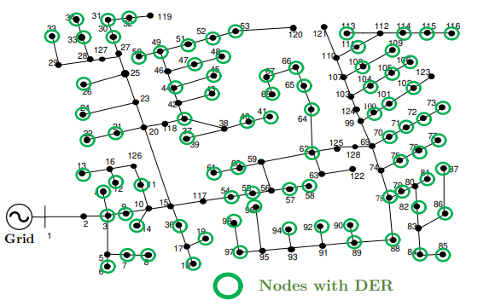
Network for the OpenDSS Model
Test Case: IEEE123 Node System with photovoltaics (PVs)
Network Model: Balanced three-phase (with no phase coupling, akin to single-phase) active power distribution network.

Slide 3
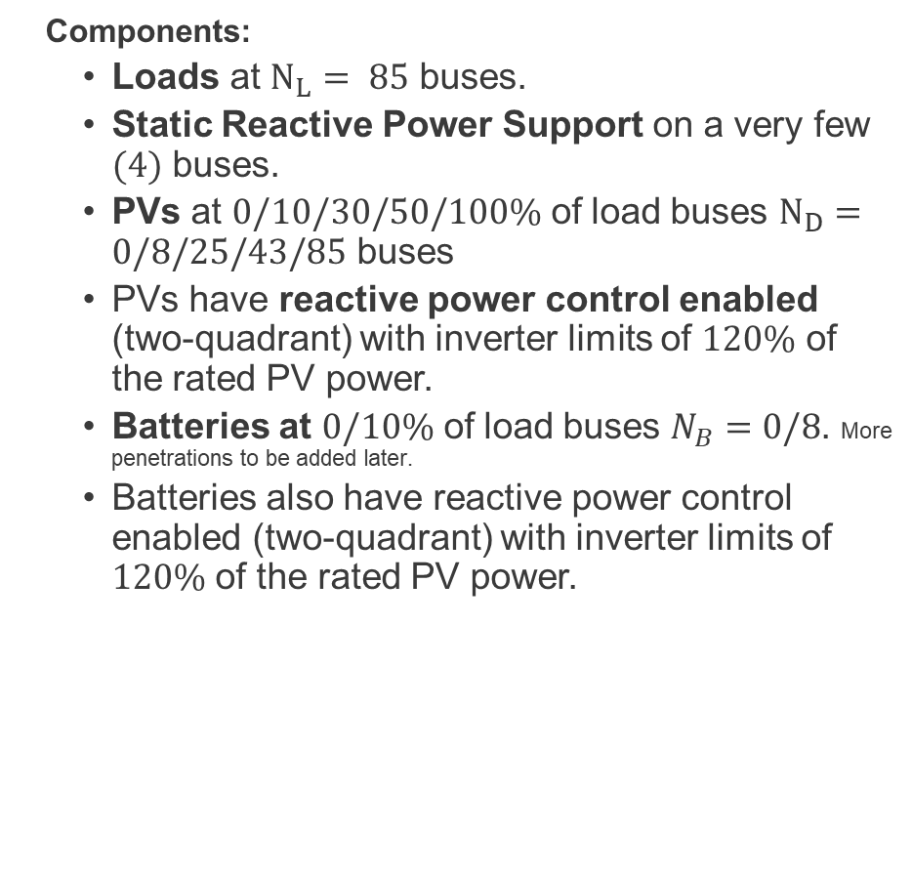
Network for the OpenDSS Model (contd.)
Components:
Loads at $N_{L}= 85$ buses.
Static Reactive Power Support on a very few $(4)$ buses.
PVs at $0/10/30/50/100\%$ of load buses $N_{D}=0/8/25/43/85$ buses
PVs have reactive power control enabled (two-quadrant) with inverter limits of $120\%$ of the rated PV power.
Batteries at $0/10\%$ of load buses $N_{B}=0/8$. More penetrations to be added later.
Batteries also have reactive power control enabled (two-quadrant) with inverter limits of $120\%$ of the rated PV power.

Slide 4
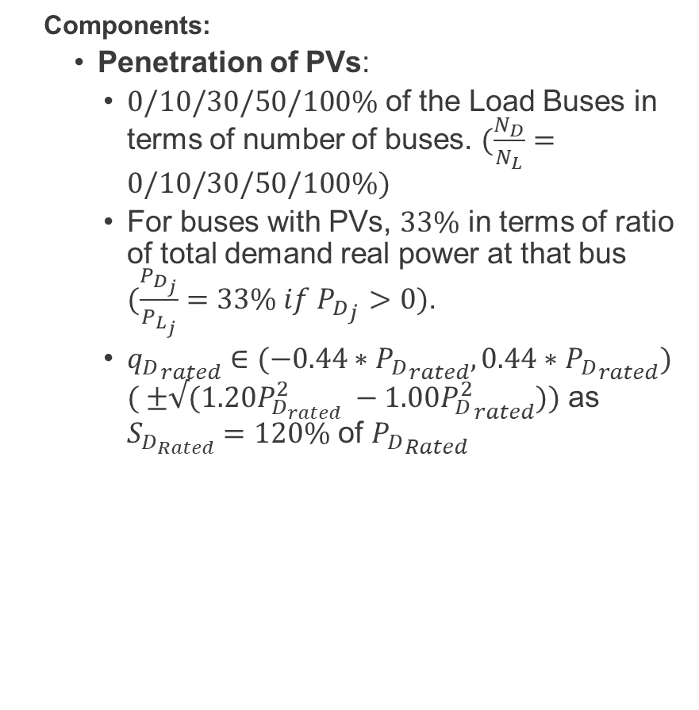
Network for the OpenDSS Model (contd.)
Components:
Penetration of PVs:
$0/10/30/50/100\%$ of the Load Buses in terms of number of buses. $(\frac{N_{D}}{N_{L}}=0/10/30/50/100\%)$
For buses with PVs, $33\%$ in terms of ratio of total demand real power at that bus $(\frac{P_{D_{j}}}{P_{L_{j}}}=33\% if {P_{D}}_{j}>0)$.
${q_{D}}_{rated}∈(−0.44∗{P_{D}}_{rated}, 0.44∗{P_{D}}_{rated})$ $( ±√({1.20P}_{D_{rated}}^{2} −{{1.00P}_{D}^{2}}_{rated}))$ as $S_{D_{Rated}}=120\%$ of ${P_{D}}_{Rated}$

Slide 5
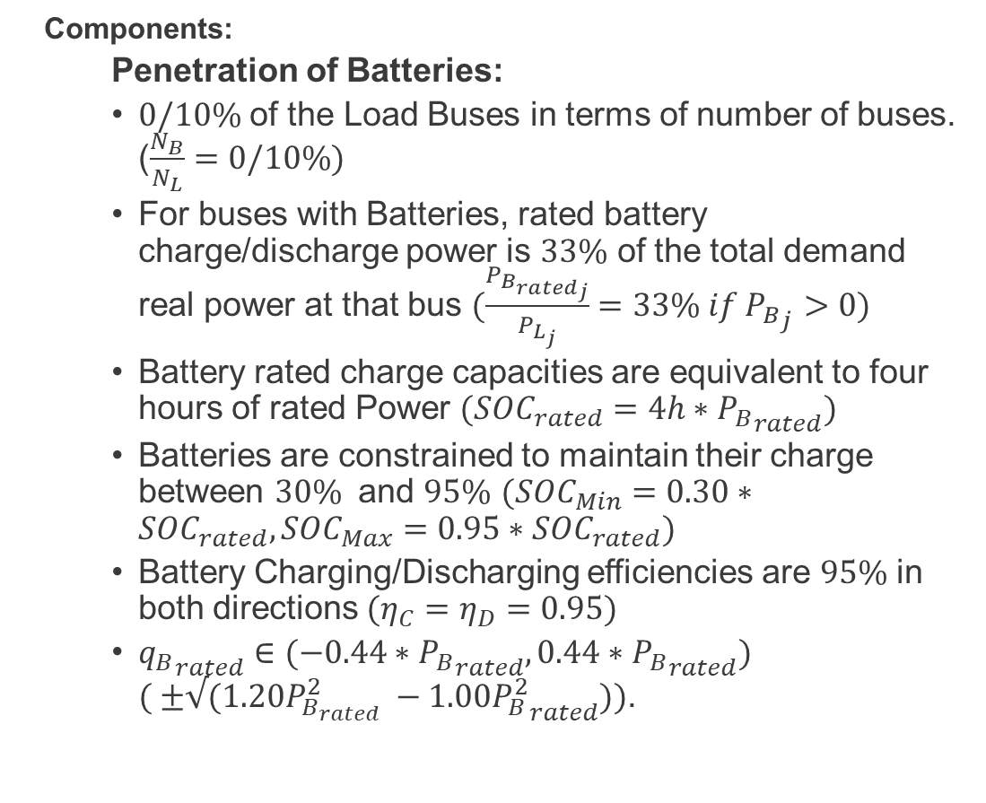
Network for the OpenDSS Model (contd.)
Components:
Penetration of Batteries:
$0/10\%$ of the Load Buses in terms of number of buses. ($\frac{N_{B}}{N_{L}}=0/10\%)$
For buses with Batteries, rated battery charge/discharge power is $33\%$ of the total demand real power at that bus $(\frac{P_{{B_{rated}}_{j}}}{P_{L_{j}}}=33\% if {P_{B}}_{j}>0)$
Battery rated charge capacities are equivalent to four hours of rated Power $(SOC_{rated}=4h∗{P_{B}}_{rated})$
Batteries are constrained to maintain their charge between $30\%$ and $95\%$ $(SOC_{Min}=0.30∗SOC_{rated}, SOC_{Max}=0.95∗SOC_{rated})$
Battery Charging/Discharging efficiencies are $95\%$ in both directions $(η_{C}=η_{D}=0.95)$
${q_{B}}_{rated}∈(−0.44∗{P_{B}}_{rated}, 0.44∗{P_{B}}_{rated})$ $( ±√({1.20P}_{B_{rated}}^{2} −{{1.00P}_{B}^{2}}_{rated}))$.

Slide 6
Running the Model using OpenDSS GUI
The zip file contains several .DSS files and a README file.
Master-OpenDSS.dss in the zip file may be run in OpenDSS for powerflow results.
README.md (or README.txt) have more information on the files as part of the system.

Slide 7


Some Powerflow results hourly, for $24$ hours
For the following configurations, Powerflow results, in terms of $P_{Subs}$: Power borrowed from the substation, $P_{Loss}$: Line Losses, and Voltage values for every node $V_{j} j∈1:N$ plots have been added here for select hours.
‘Base Case’ – IEEE 123 Single Phase Distribution Network with $0\%$ PVs and $0\%$ Batteries
-with $10\%$ PVs
-with $10\%$ PVs and $10\%$ Batteries

Slide 8
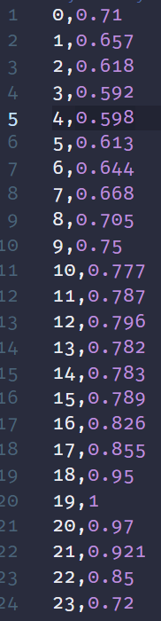
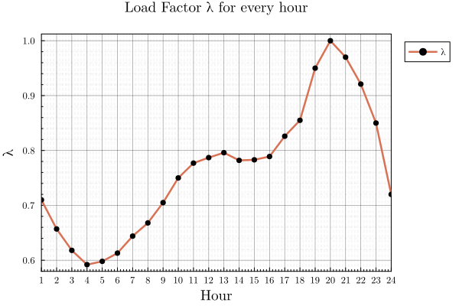

Preliminary notes for Powerflow results
LoadShape
Borrowed from OpenDSS’s LoadShape1.csv, as given in the Storage Controller Example (for IEEE $8500$ node system).

Slide 9
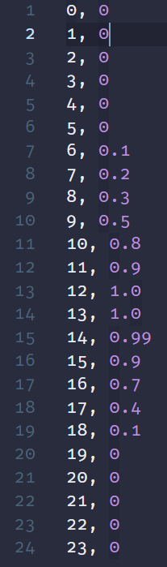
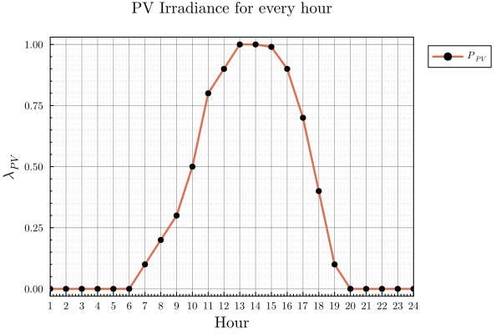
Preliminary notes for Powerflow results
PV Profile
Borrowed from Paul Radatz's example in Paulo_Example/DSSFiles/pvsystemexample where the same data is labelled as Loadshape.MyIrrad

Slide 10
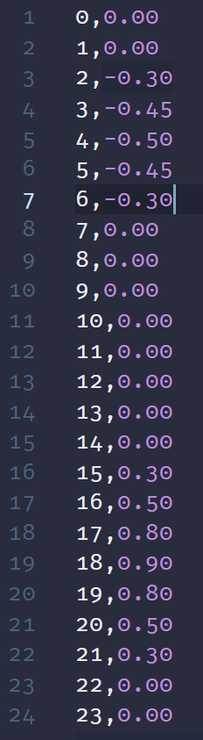
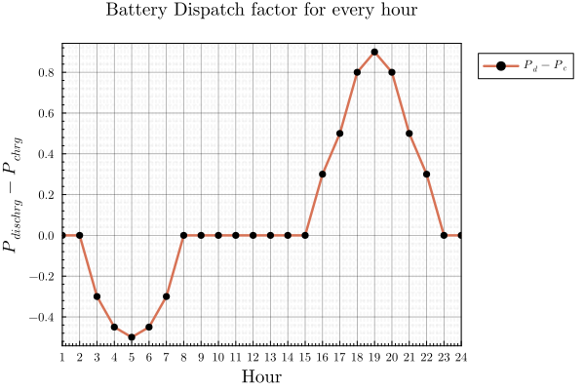

Preliminary notes for Powerflow results
LoadShape_Storage
Borrowed from OpenDSS’s common_SC_loadshape array in StorageControl.dss, as given in the Storage Controller Example (for IEEE $8500$ node system).

Slide 11
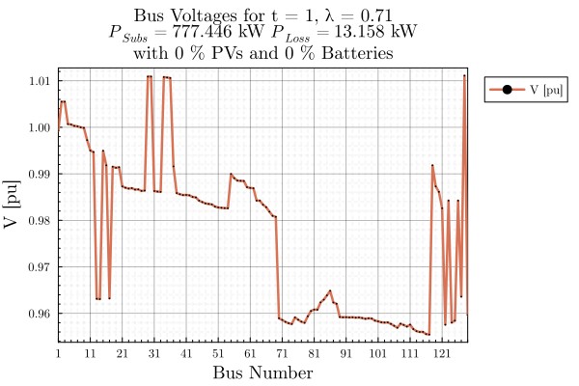
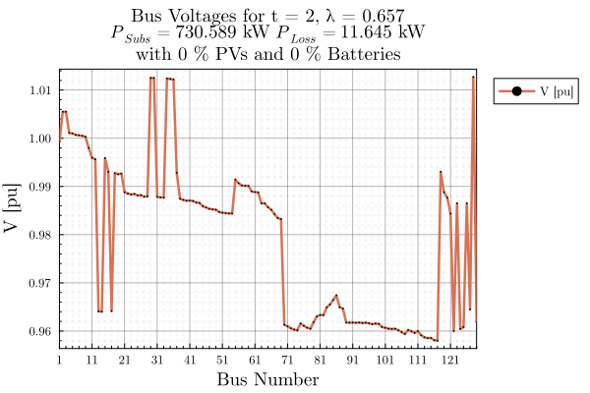

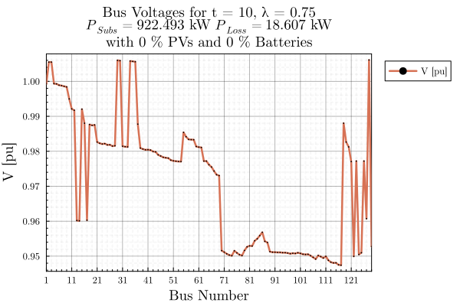
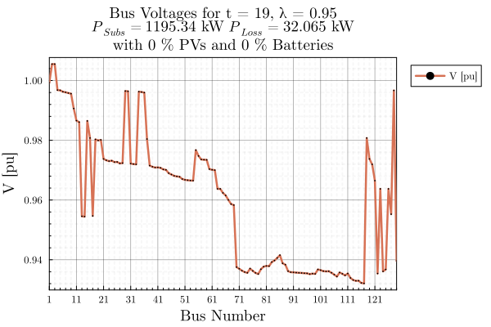

Some Powerflow results Base case

Slide 12
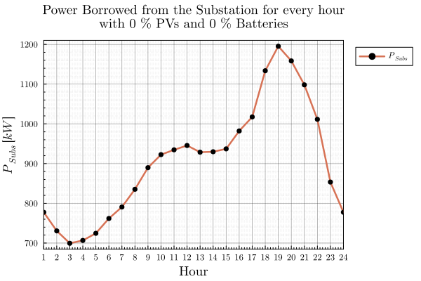
Some Powerflow results Base case

Slide 13
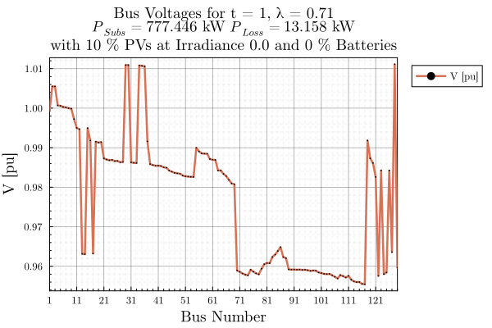
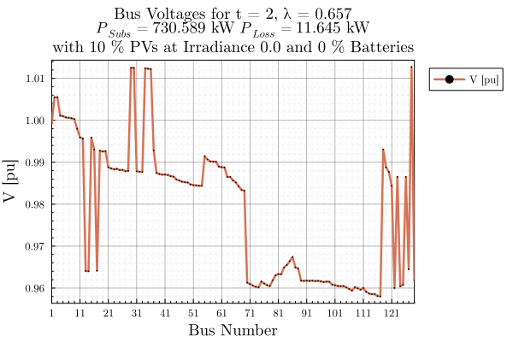
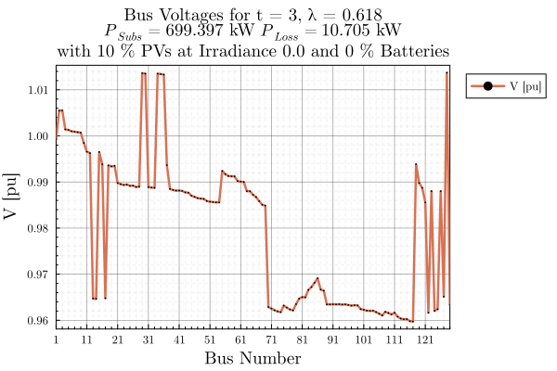
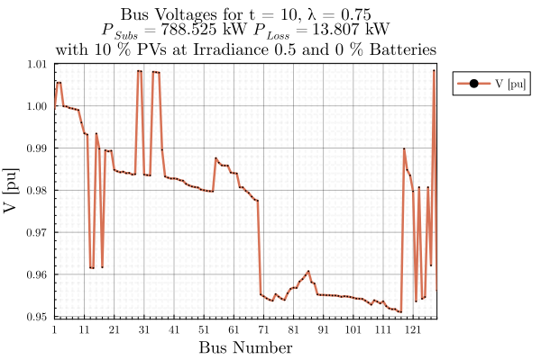
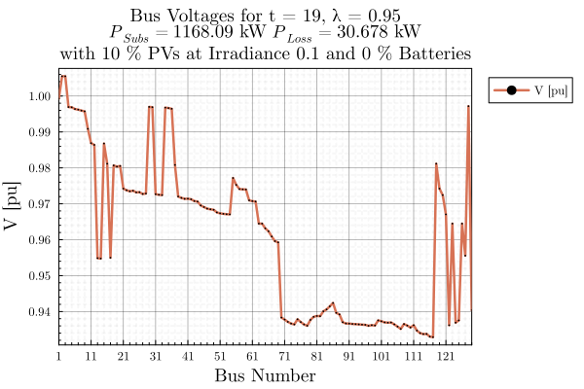


Some Powerflow results $10\%$ PVs

Slide 14
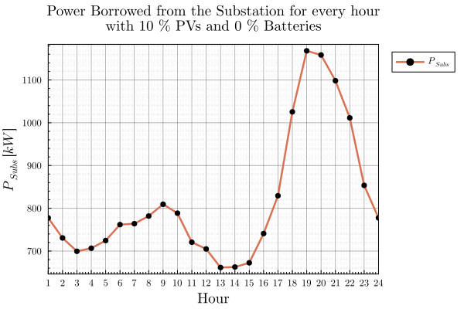

Some Powerflow results $10\%$ PVs

Slide 15


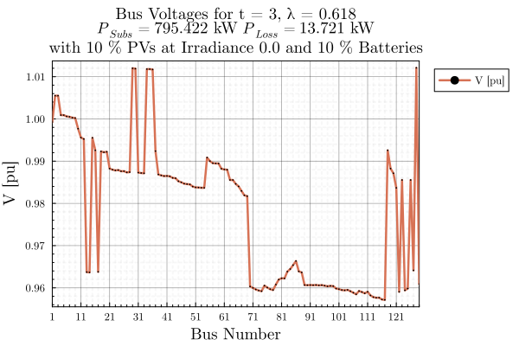
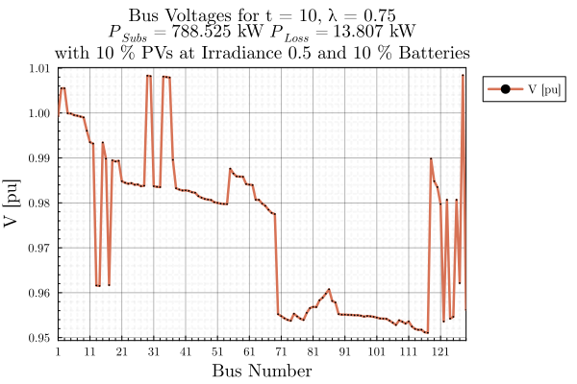



Some Powerflow results $10\%$ PVs + $10\%$ Batteries

Slide 16
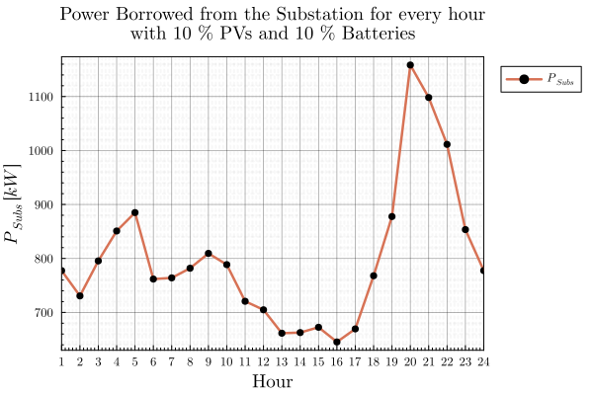

Some Powerflow results $10\%$ PVs + $10\%$ Batteries

Slide 17
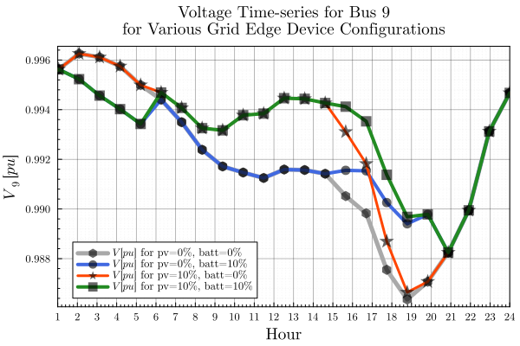
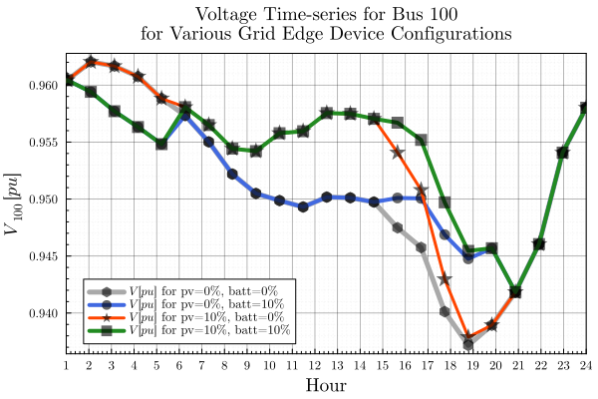
Voltage Timeseries for All GED Configurations
Voltages were plotted against time for select buses under various GED penetration configurations, such as No Solar No Storage (gray), Only Storage (blue), Only Solar (orange) and Solar + Storage (green).

Slide 18
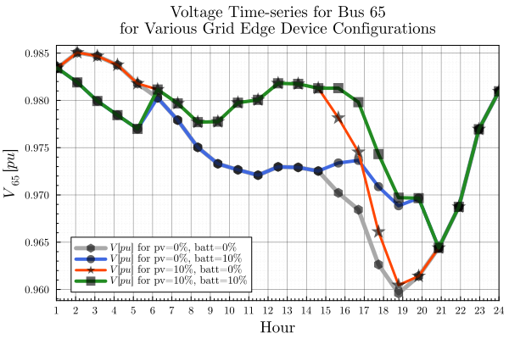
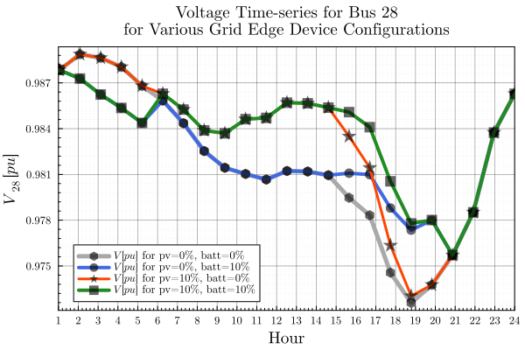
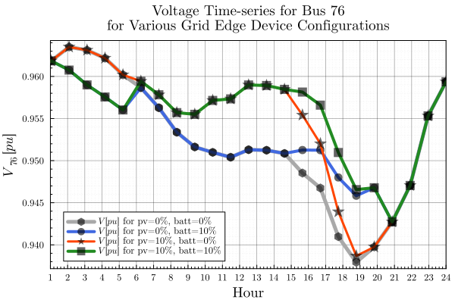



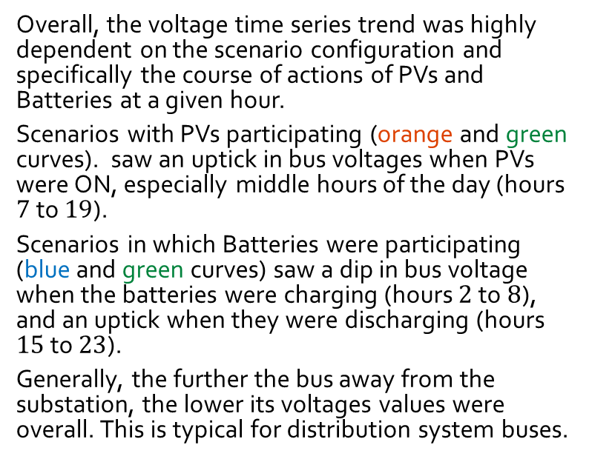
Voltage Timeseries for All GED Configurations
Overall, the voltage time series trend was highly dependent on the scenario configuration and specifically the course of actions of PVs and Batteries at a given hour.
Scenarios with PVs participating (orange and green curves). saw an uptick in bus voltages when PVs were ON, especially middle hours of the day (hours $7$ to $19$).
Scenarios in which Batteries were participating (blue and green curves) saw a dip in bus voltage when the batteries were charging (hours $2$ to $8$), and an uptick when they were discharging (hours $15$ to $23$).
Generally, the further the bus away from the substation, the lower its voltages values were overall. This is typical for distribution system buses.

Slide 19
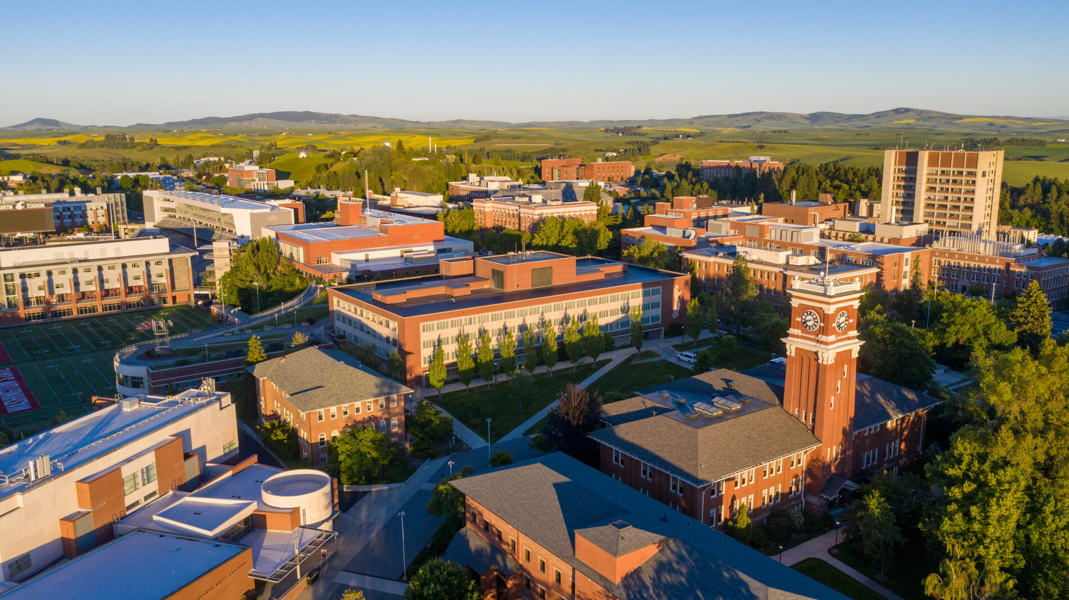
Thank You.

